Slide 1
VOICE RECOGNITION USING GENERATIVE ARTIFICIAL INTELLIGENCE
CREATED BY
SURIYAN.PA
REG.NO:912321104048
III RD YEAR-CSE
SACS M.A.V.M.M. ENGINEERING COLLEGE
ALAGAR KOVIL,MADURAI.

Slide 2
AGENDA
PROBLEM STATEMENT
PROPOSED SYSTEM/SOLUTION
SYSYTEM DEVELOPMENT APPROACHES
ALGORITHM AND DEPLOYMENT
RESULT
REFERENCES
CONCLUSION

Slide 3
PROBLEM STATEMENT
Developing a robust voice recognition system using generative artificial intelligence (AI) poses several challenges. The primary goal is to create a model that can accurately understand and transcribe spoken language with high fidelity. However, traditional approaches to voice recognition often struggle with noisy environments, accents, and variations in speech patterns.

Slide 4
PROPOSED SYSTEM/SOLUTION
Data collection and preprocessing
Model architecture
Training strategy
Noise robustness
Accent and dialect adaptation
Real-time processing
Privacy-preserving measures
Scalability and integration
Evaluation and testing

Slide 5
PROPOSED SYSTEM/SOLUTION(contd...)
1.Data Collection and Preprocessing:
Gather a diverse dataset of spoken language samples, encompassing various accents,dialects, and speech Patterns . Preprocess the data to remove noise,normalize audio levels, and segment utterances for training.
2.Model architecture:
Implement a deep learning architecture tailored for voice recognition, suchas recurrent neural networks (RNNs), convolutional neural networks(CNNs), or transformer models.Generative AI techniques like WaveNet or Tacotron for waveform synthesis and text-to-speech conversion.
3.Training strategy:
Utilize large-scale datasets and techniques like data augmentation to improve model robustness.Employ transfer learning from pre-trained models to leverage knowledge from related tasks, such as speech synthesis or natural language processing.

Slide 6
PROPOSED SYSTEM/SOLUTION
4.Real-time Processing:
Optimize model architecture and inference algorithms for low-latency processing, enabling real-time transcription and feedback.Implement parallelization and hardware acceleration (e.g., GPU or TPU) to speed up inference without sacrificing accuracy.
5.Scalability and Integration:
Design the system with scalability in mind, using cloud-based infrastructure or containerization to handle increasing user demand.Provide easy-to-use APIs and SDKs for seamless integration with existing software applications, mobile devices, and IoT devices.
6.Evaluation and Testing:
Evaluate the model's performance using standard metrics like word error rate (WER) and accuracy on held-out validation datasets.

Slide 7
SYSTEM DEVELOPMENT APPROACHES
Developing a voice recognition system using generative artificial intelligence involves several approaches, Here are some key system development approaches for voice recognition using generative AI
End-to-End Model Training:
Train a single end-to-end model that directly maps input audio waveforms to text transcripts without intermediate representationsConsiderations: Requires a large amount of training data and computational resources, and may be less interpretable compared to modular approaches.
Hybrid Models:
Combine generative AI techniques with traditional signal processing methods or rule-based systems.Considerations: Requires careful integration and tuning of different components, potentially increasing complexity and development effort.
Transfer Learning:
Fine-tune pre-trained generative AI models, such as WaveNet or Tacotron, on voice recognition tasks.Advantages: Exploits pre-trained models' knowledge and features learned from large scale datasets, reducing the need for extensive training data and accelerating development.

Slide 8
SYSTEM DEVELOPMENT APPROACHES(Contd...)
Data Augmentation and Synthesis:
Augment training data with artificially generated samples, perturbations, or transformations to improve model generalization and robustness.Considerations: Requires careful selection and design of augmentation techniques to avoid introducing bias or artifacts into the data.
Adversarial Training:
Train generative models adversarially against discriminative models or adversarial examples to improve robustness against adversarial attacks or noise.Considerations: Requires additional computational resources and careful tuning of adversarial training parameters to achieve desired performance gains.
Incremental Learning and Adaptation:
Continuously update and refine the voice recognition model over time using online learning or transfer learning techniques.Advantages: Enables the system to adapt to changing user preferences, environments, or data distributions, improving long-term performance and user satisfaction.

Slide 9
ALGORITHM AND DEPLOYMENT
ALGORITHM :
Data Preprocessing: Collect a dataset of audio recordings paired with corresponding transcripts.Preprocess the audio data by converting it into a suitable format (e.g., spectrograms) and normalize the audio levels.
Model Selection: Choose a generative AI model suitable for voice recognition tasks, such as Tacotron, WaveNet, or DeepSpeech.Consider the architecture's ability to handle sequential data and generate accurate representations of speech.
Model Training: Split the dataset into training, validation, and test sets.Train the generative model using the training data, optimizing for transcription accuracy and fluency.Monitor the model's performance on the validation set and adjust hyperparameters as needed to prevent overfitting.
Evaluation: Evaluate the trained model's performance on the test set using metrics like word error rate (WER) or character error rate (CER).Assess the model's ability to accurately transcribe speech across different accents, languages, and environmental conditions.

Slide 10
ALGORITHM AND DEPLOYMENT
DEPLOYMENT:
Infrastructure Setup:Provision the necessary computational resources, such as cloud-based servers or on-premises hardware.Configure network infrastructure for communication between clients and the deployed system.
Model Packaging:Package the trained generative AI model along with any associated dependencies or preprocessing steps into a deployable format, such as a container (e.g., Docker image) or a model file compatible with inference frameworks (e.g., TensorFlow Serving).
Deployment Environment Configuration:Set up the deployment environment, including installing required software libraries, configuring runtime settings, and ensuring compatibility with the deployed model.
API Development:Develop an API (Application Programming Interface) for the voice recognition system to allow client applications to send audio inputs and receive transcribed text outputs.

Slide 11
DATASET STATE
Dataset for voice recognization using generative artificial intelligence
https://www.kaggle.com/datasets/shabareesharyan/voice-dataset

Slide 12
IMPLEMENTATION
import numpy as np
mport pandas as pd
import matplotlib.pyplot as plt
import seaborn as snsdf = pd.read_csv('../input/voice-dataset/voice.csv')
df.head()
df.shape
df.isna().sum()
df['label'].value_
counts()val= [1584,1584]
Label=['male','female']plt.figure(figsize=(6,8))
plt.pie(val,labels=label)
plt.legend()plt.show()corr = df.corr()sns.set(font_scale=1.5)
plt.figure(figsize=(20,2)
plt.show()corr = df.corr()
Corr=corr[corr>0.85]plt.figure(figsize0))
sns.heatmap(corr,annot = True,cmap='coolwarm') =(15,15))
sns.heatmap(corr,annot = True,cmap='coolwarm')
plt.show()df = df.drop(['meanfreq','centroid',],axis=1)
columnssns.boxplot(x=df.maxdom,y=df.label)
plt.show()sns.boxplot(x=df.dfrange,y=df.label)
plt.show()
sns.boxplot(x=df.dfrange,y=df.label)
plt.show()df = df.drop(['dfrange','maxdom'],axis=1)
Df=df.drop(['kurt','skew'],axis=1)sns.boxplot(x=df['skew'],y=df.label)
plt.show()sns.boxplot(x=df['kurt'],y=df.label)
plt.show()sns.boxplot(x=df['sd'],y=df.label)
plt.show()sns.boxplot(x=df['IQR'],y=df.label)
plt.show()
df.drop(['IQR'],axis=1)
sns.boxplot(x=df['sfm'],y=df.label)
plt.show()sns.boxplot(x=df['sp.ent'],y=df.label)
plt.show()
df = df.drop('sp.ent',axis=1)
sns.pairplot(df,kind = 'boxplot',hue='label')
plt.show()df = df.drop(['maxfun','modindx','minfun'],axis=1)
scorr = df.corr()
corr[corr>0.85]plt.figure(figsize=(5,5))
sns.heatmap(corr,annot = True,cmap='coolwarm')
plt.show()

Slide 13
IMPLEMENTATION(Contd...)
from sklearn.model_selection
import train_test_splitX_train,x_test,y_train,y_test = train_test_split(X,y,test_size=0.2,random_state = 1)
X = df.iloc[:,:-1]y = df.label
from sklearn.metrics
import classification_report,confusion_matrix
def eval(y_pred,ytest):
print("Confusion matrix:\n")
cm = confusion_matrix(y_pred,ytest)
sns.heatmap(cm,annot = True,xticklabels=["Female","Male"],yticklabels=["Female","Male"])
plt.show()
print("Classification Report\n",classification_report(y_pred,ytest))
def score(model):
print("Training score: ",model.score(X_train,y_train))
print("Test score: ",model.score(x_test,y_test))
from sklearn.tree
import DecisionTreeClassifier
DTmodel = DecisionTreeClassifier(min_samples_split = 5,max_depth = 10,random_state = 0)
ypred1 = DTmodel.predict(x_test)ypred1[:5]
DTmodel.fit(X_train,y_train)
eval(ypred1,y_test)

Slide 14
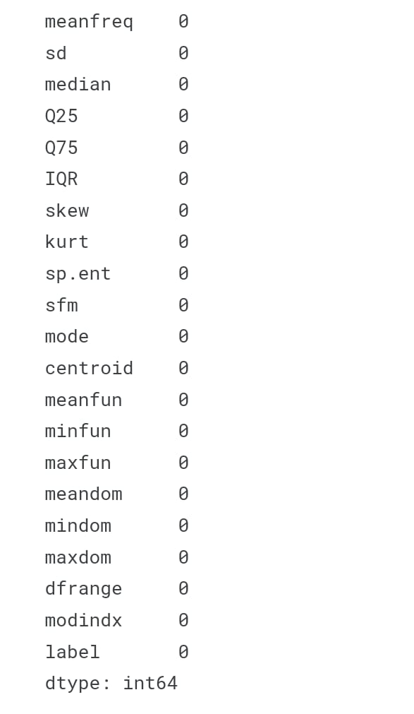
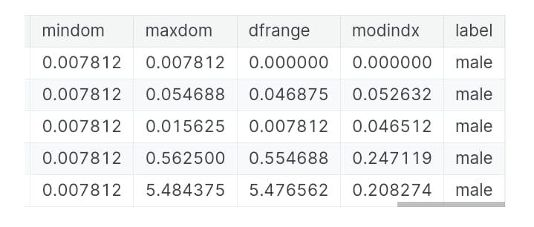
RESULT

Slide 15
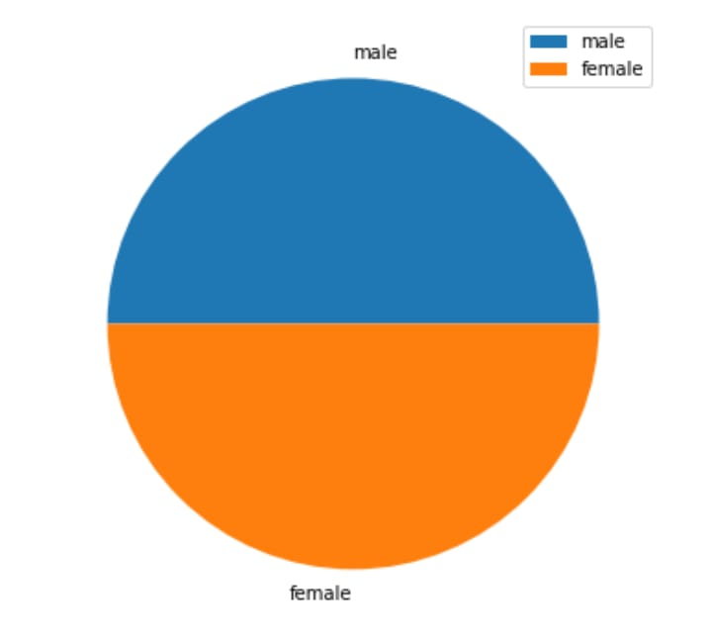
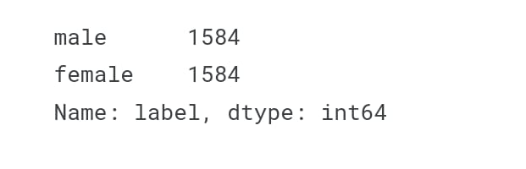
RESULT(Contd...)

Slide 16
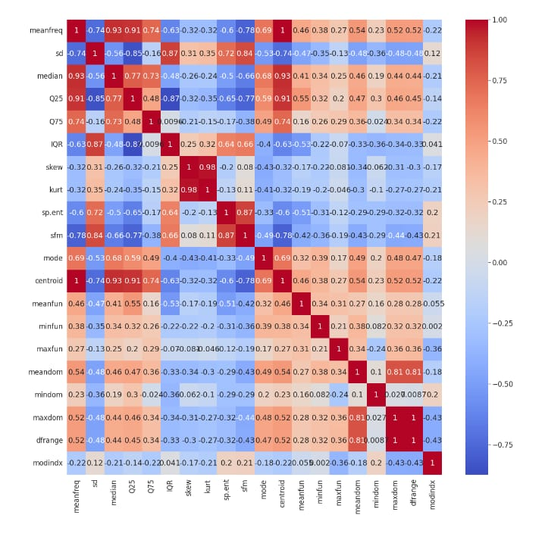
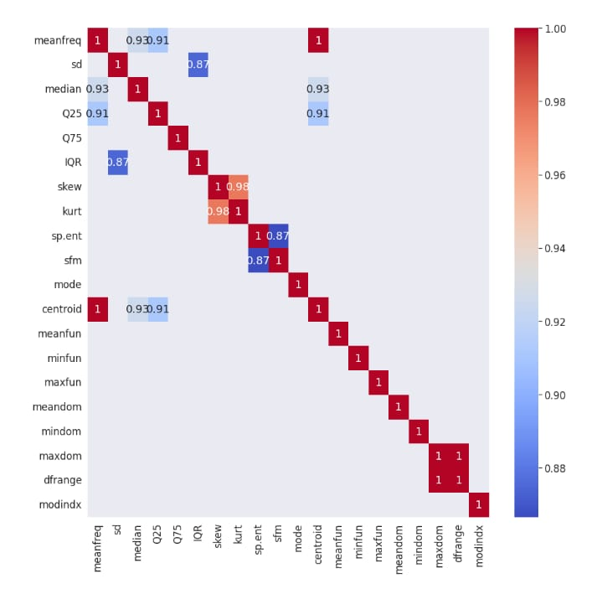
RESULT(Contd...)

Slide 17
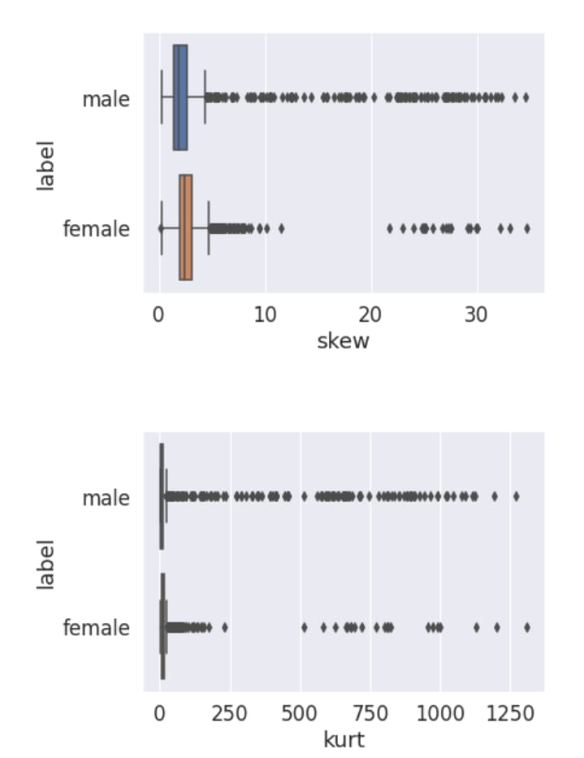
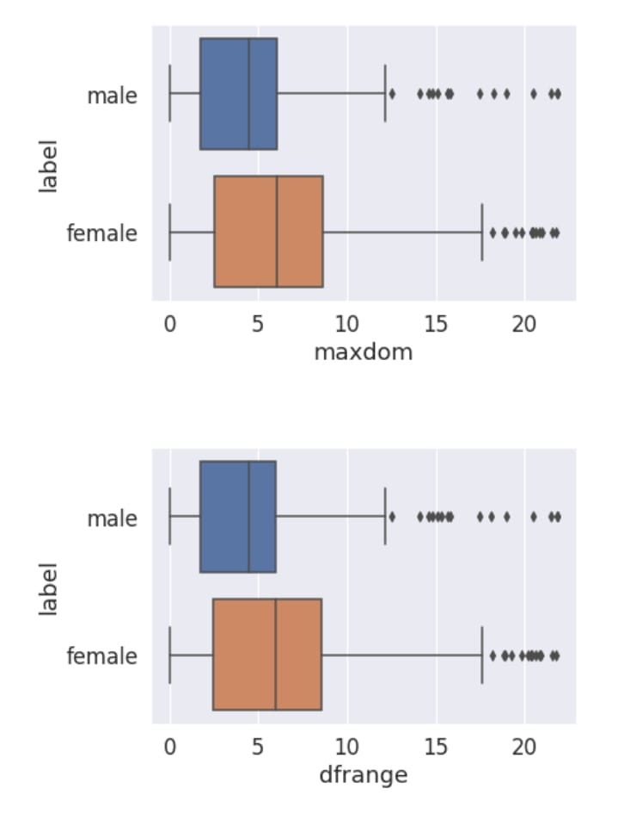
RESULT(Contd...)

Slide 18
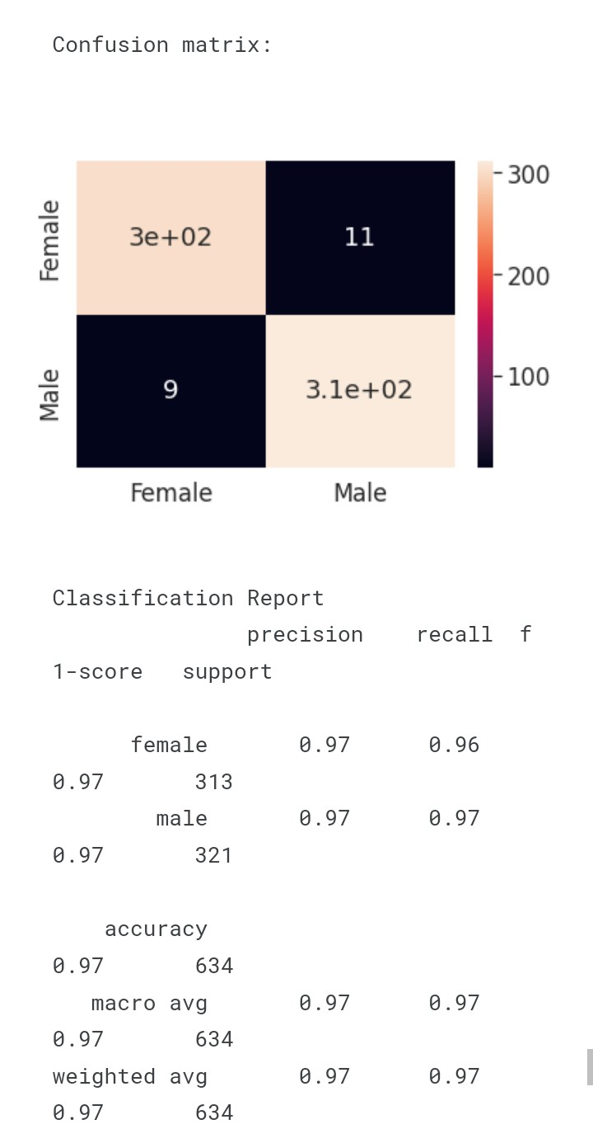
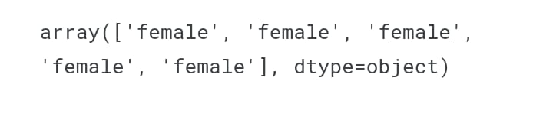
RESULT(Contd...)

Slide 19
REFERENCES
https://numpy.org/
https://pandas.pydata.org/
https://matplotlib.org/
https://seaborn.pydata.org/

Slide 20
CONCLUSION
voice recognition using generative artificial intelligence algorithms holds great promise for improving accuracy and robustness in speech recognition systems. By leveraging generative models, such as GANs or VAEs, we can enhance the quality of synthesized speech, enabling more natural and human-like interactions. However, challenges remain, particularly in addressing data privacy concerns and ensuring ethical use of synthesized voices. Continued research and development in this field are essential to unlock the full potential of voice recognition powered by generative AI.

Slide 21
THANK YOU!

